Slide 1
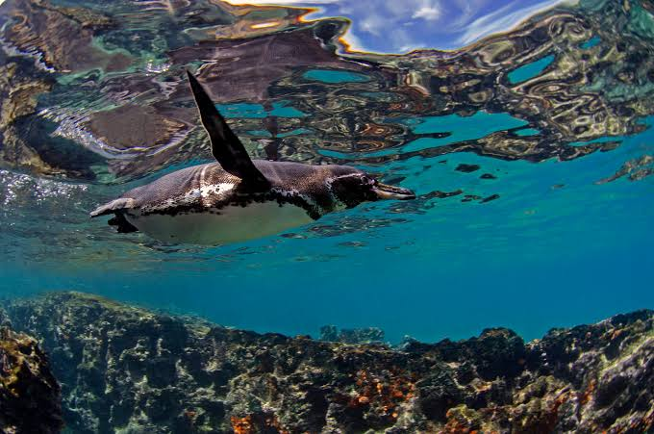

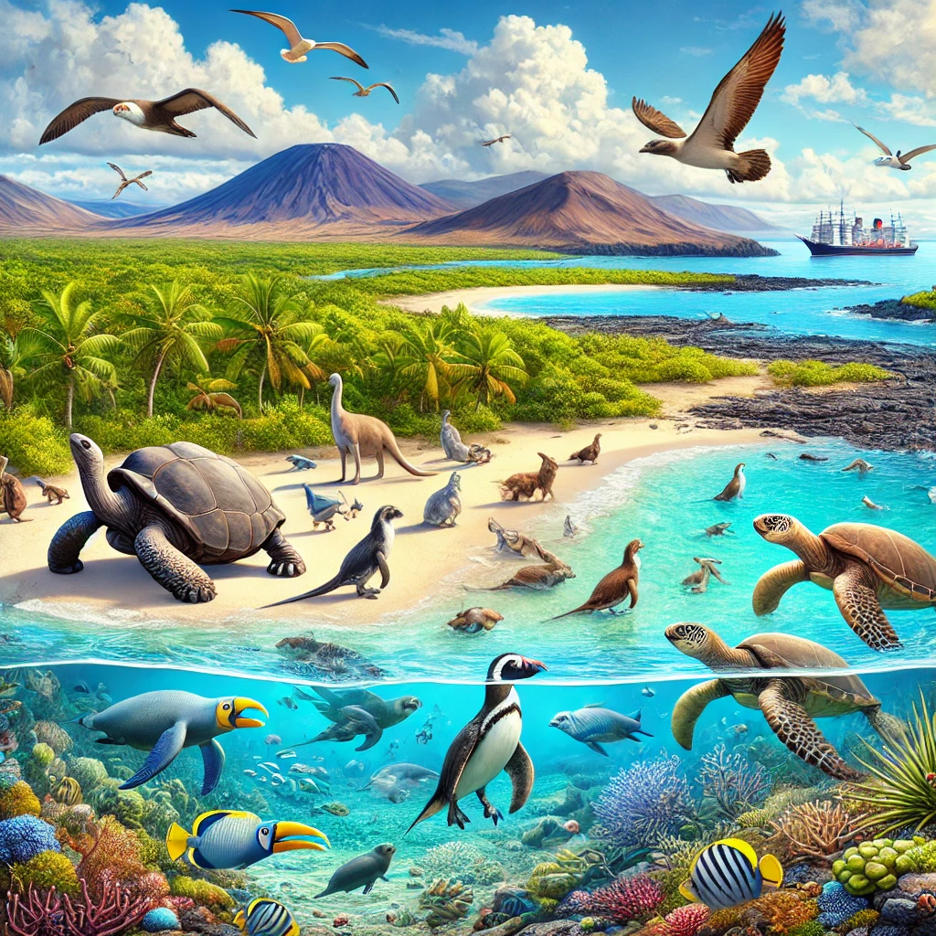
Linear Regression
Lab 5| Linear Regression using Galapagos Island Data OCNG 470 Data Analysis Methods in Geosciences
Fall 2025 TAMU Oceanography
Oceanography
OCNG 470 Data Analysis Methods in Geosciences (Lab portion)

Slide 2
Lab 5 Assignment
Lab Objectives:
Calculate linear regression variables and confidence intervals based on Galapagos Island data set from the textbook.
Plot data with confidence intervals.
Lab Activities:
Part A: Working with Galapagos Islands data (from Gotelli & Ellison’s textbook)
Part B: Investigate linear regressions with noises
See the detailed instructions uploaded to Canvas

Slide 3
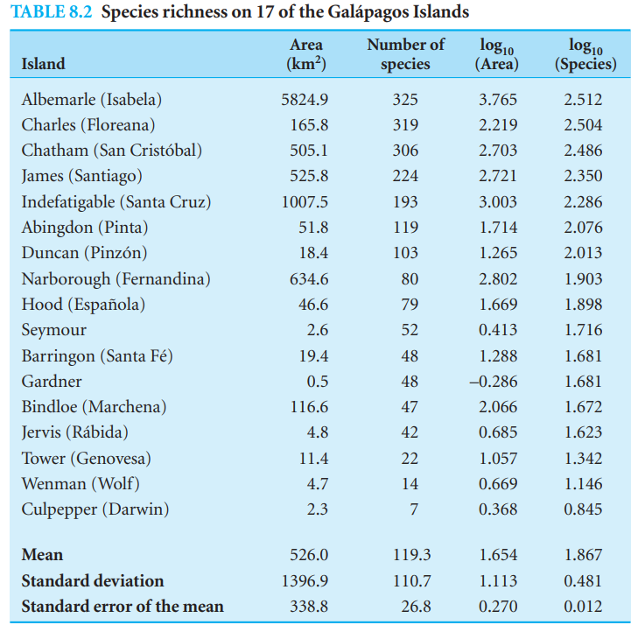
Overview of the dataset for lab 5
Plant species richness and island area for 17 Galapagos Islands (Table 8.2).
Paired observations of the island’s area and its corresponding number of plant species.
We want to find the relationship between the number of species and the island area.
The confidence interval describes the uncertainty in the collected data.
Prediction interval is used to evaluate new data not yet collected or included in the analysis.

Slide 4
Plot your data
Expected output: Figure 1
3.5
Galapagos Data (n = 17)
Dark Blue Line:
  Shows the relationship between island area and number of plant species.
  As island area increases, the number of plant species also increases.
95% Confidence Interval (Light Blue):
  The range where the true relationship likely falls.
  Narrow near average island area (more data).
  Wider further away (less certainty).
Logarithmic Scale:
  Both variables use a log scale to better show trends over a wide range of values.
3
2.5
log
₁₀ (Number of species)
2
1.5
1
0.5
0
-1
-0.5
0
0.5
1 1.5
log
₁₀ (Island area)
2
2.5
3
3.5
4

Slide 5
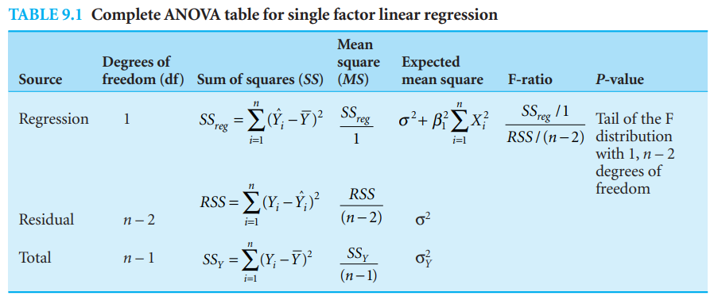
The equations you will need can be found in Chapter 9

Slide 6
Part B: Investigate linear regressions with noises
Objective: Understand how data variability affects regression outcomes

Slide 7
Plot your data
Expected output: Figure 2
i = 0 i = 1 i = 2
20 20 20 20
15 15 15 15
10 10 10 10
5 5 5 5
0 0 0 0
i = 3
yyy
yyy
yyy
yyy
-5 -5 -5 -5
4 6
xxx
i = 7
How did noise impact your regression results?
What does this tell you about real-world data?
Report your findings.
2
4 6
xxx
i = 4
8 10 2
4 6
xxx
i = 5
8 10 2
4 6
xxx
i = 6
8 10
2
8 10
20
20
20
20
15
15
15
15
10
10
10
10
yyy
5
yyy
5
yyy
5
yyy
5
0
0
0
0
-5
2
4 6
xxx
i = 8
8 10
-5
2
4 6
xxx
i = 9
8 10
-5
2
4 6
xxx
i = 10
8 10
-5
2
4 6
xxx
8 10
20
20
20
15
15
15
10
10
10
yyy
5
yyy
5
yyy
5
0
0
0
-5
2
4 6
xxx
8 10
-5
2
4 6
xxx
8 10
-5
2
4 6
xxx
8 10

Slide 8
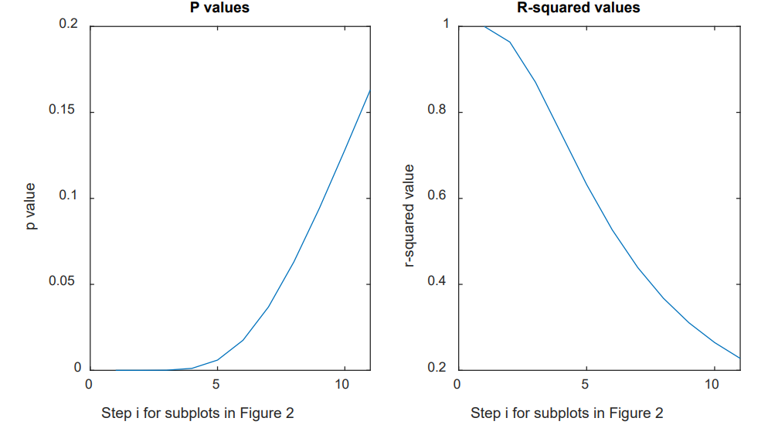
Plot your data
Expected output: Figure 3
What is the behavior of p-values and r-squared with increasing noise?
Report your findings.

